Slide 1

CLASSES AND PACKAGES - JAVA
Java Full Stack Program

Slide 2
What is class?
In object-oriented programming , a class is a template definition of the method’s and variable’s in a particular kind of object. Thus, an object is a specific instance of a class; it contains real values instead of variables.
The class is one of the defining ideas of object-oriented programming. Among the important ideas about classes are:
A class can have subclasses that can inherit all or some of the characteristics of the class. In relation to each subclass, the class becomes the superclass.
Subclasses can also define their own methods and variables that are not part of their superclass.
The structure of a class and its subclasses is called the class hierarchy.
Java Full Stack Program

Slide 3
Objects and Classes
An object is a program construct
Contains data
Performs actions
Objects interact to solve problems
Actions performed by objects are defined by methods
Java Full Stack Program

Slide 4
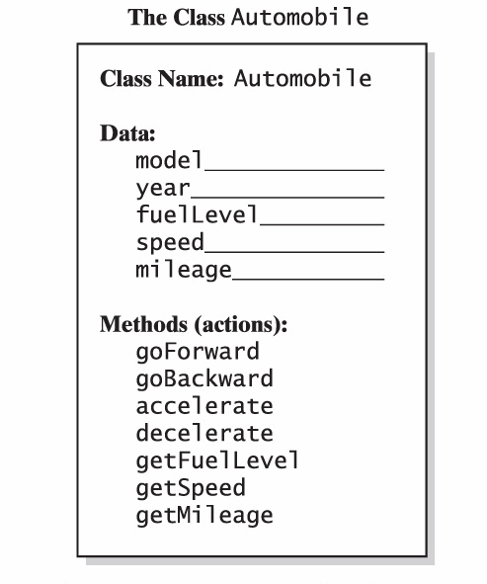
Objects and Classes
A class is a kind of object
A class definition is a general description of
what the object is
what it can do
Java Full Stack Program

Slide 5
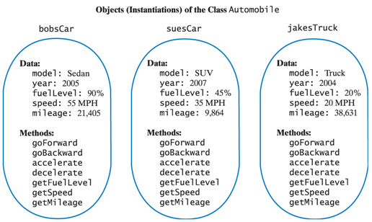
Objects and Classes
All objects in the same class have
the same kinds of data
the same methods
Java Full Stack Program

Slide 6
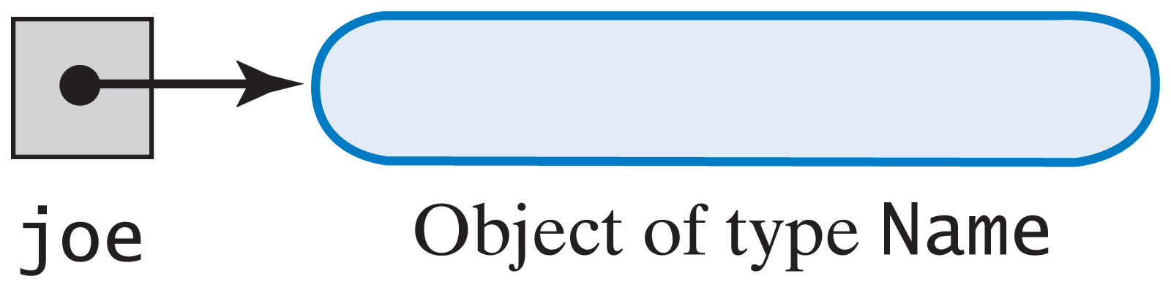
Using the Methods in a Java Class
Given a class called Name
Declare a variable Name joe;
Create an instance of Name joe = new Name();
Alternatively Name joe = new Name();
Java Full Stack Program

Slide 7

Using the Methods in a Java Class
void methods are used to do a task such as set the first or last names
valued methods return a single value
Java Full Stack Program

Slide 8
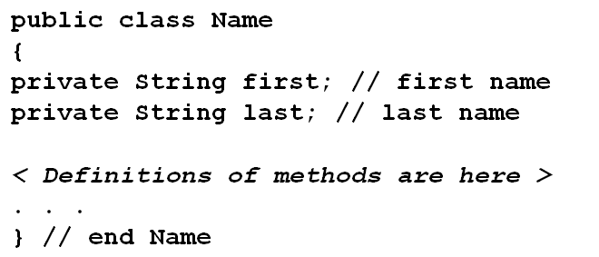
Defining a Java Class
Access or visibility modifiers
Specifies where a class, data field, or method can be used.
Data members
Java Full Stack Program

Slide 9
Defining a Java Class
Methods that classes often use:
Accessor (query) methods – return value of a data field
Mutator methods – change the value of a data field
Java Full Stack Program

Slide 10
Enumeration as a Class
Consider the following example of an enumeration of card suits
View definition of class Suit
Note constructor, getColor
View demonstration program
View class LetterGrade
An enumeration class
Note class elements
Java Full Stack Program

Slide 11
Packages
What is Packages?
Packages are Java’s way of grouping a number of related classes and/or interfaces together into a single unit. That means, packages act as “containers” for classes.
The benefits of organising classes into packages are:
The classes contained in the packages of other programs/applications can be reused.
In packages classes can be unique compared with classes in other packages. That two classes in two different packages can have the same name. If there is a naming clash, then classes can be accessed with their fully qualified name.
Classes in packages can be hidden if we don’t want other packages to access them.
Packages also provide a way for separating “design” from coding.
Java Full Stack Program

Slide 12
Java Foundation Packages
Java provides a large number of classes groped into different packages based on their functionality
The six foundation Java packages are:
java.lang :
Contains classes for primitive types, strings, math functions, threads,and exception.
java.util :
Contains classes such as vectors, hash tables, date etc.
java.io :
Stream classes for I/O .
java.awt :
Classes for implementing GUI – windows, buttons, menus etc.
java.net :
Classes for networking .
java.applet :
Classes for creating and implementing app.
Java Full Stack Program

Slide 13
Accessing Classes from Packages
There are two ways of accessing the classes stored in packages:
Using fully qualified class name
java.lang.Math.sqrt(x);
Import package and use class name directly
import java.lang.Math
Math.sqrt(x);
Selected or all classes in packages can be imported:
import package.class;
import package.*;
Implicit in all programs: import java.lang.*;
package statement(s) must appear first
Java Full Stack Program

Slide 14
Creating Packages
Java supports a keyword called “package” for creating user-defined packages. The package statement must be the first statement in a Java source file (except comments and white spaces) followed by one or more classes.
package myPackage;
public class ClassA {
// class body
}
class ClassB {
}
Package name is “myPackage” and classes are considered as part of this package; The code is saved in a file called “ClassA.java” and located in a directory called “myPackage”.
Java Full Stack Program

Slide 15
Accessing a Package
As indicated earlier, classes in packages can be accessed using a fully qualified name or using a short-cut as long as we import a corresponding package.
The general form of importing package is:
import package1[.package2][…].classname
Example:
import myPackage.ClassA;
import myPackage.secondPackage
All classes/packages from higher-level package can be imported as follows:
import myPackage.*;
Java Full Stack Program

Slide 16
Using a Package
Let us store the code listing below in a file named“ClassA.java” within subdirectory named “myPackage”within the current directory (say “abc”).
package myPackage;
public class ClassA {
// class body
public void display()
{
System.out.println("Hello, I am ClassA");
}
}
class ClassB {
// class body
}
Java Full Stack Program

Slide 17
Using a Package
Within the current directory (“abc”) store the following code in a file named“ClassX.java”
import myPackage.ClassA;
public class ClassX
{
public static void main(String args[])
{
ClassA objA = new ClassA();
objA.display();
}
}
Java Full Stack Program

Slide 18
Compiling and Running
An ClassX.java is compiled, the compiler compiles it and places .class file in current directly. If .class of ClassA in subdirectory “myPackage” is not found, it comples ClassA also.
Note: It does not include code of ClassA into ClassX ✞
When the program ClassX is run, java loader looks for ClassA.class file in a package called “myPackage” and loads it.
Java Full Stack Program

Slide 19
Using a Package
Let us store the code listing below in a file named“ClassA.java” within subdirectory named“secondPackage” within the current directory (say“abc”).
public class ClassC
{
// class body
public void display()
{
System.out.println("Hello, I am ClassC");
} }
Java Full Stack Program

Slide 20
Using a Package
Let us store the code listing below in a file named“ClassA.java” within subdirectory named“secondPackage” within the current directory (say“abc”).
public class ClassC
{
// class body
public void display()
{
System.out.println("Hello, I am ClassC");
} }

Slide 21
Using a Package
Within the current directory (“abc”) store the following code in a file named“ClassX.java”
import myPackage.ClassA;
import secondPackage.ClassC;
public class ClassY
{
public static void main(String args[])
{
ClassA objA = new ClassA();
ClassC objC = new ClassC();
objA.display();
objC.display();
}
}

Slide 22
THANK YOU
Java Full Stack Program

